Slide 1
Thesis Defense: Analysis of Various Algorithmic Approaches to Software-Based APRS Packet Demodulation
By: Robert Campbell
Committee Members: Dr. John Bellardo, Dr. Bridget Benson, and Dr. Dennis Derickson
Notes:
Introduce People in the room

Slide 2
What is APRS?
Automated Packet Reporting System.
A digital communication method used by hams.
Encoded into the Radio Using Bell 202
Notes:
Discuss Digital vs Analog Communication. Ironic note about how APRS is both.
Packet content can be many things but most commonly is a GPS position.
Mention that Bell 202 is the key to this research (not too much detail about what it is since that will be covered later)

Slide 3
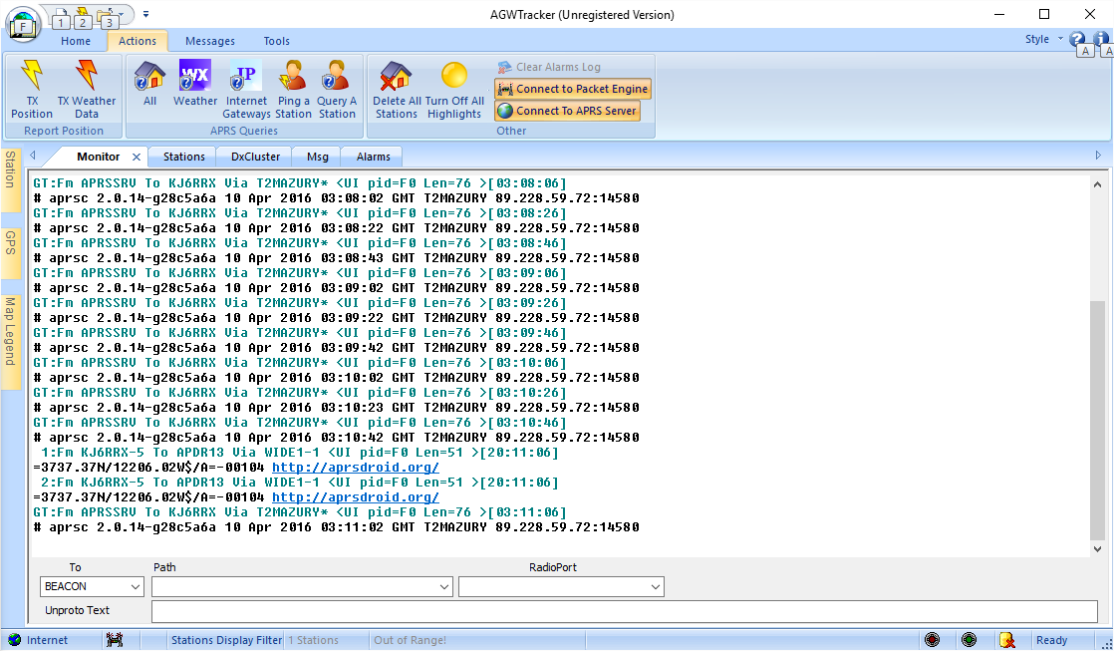
What does APRS look like?
Notes:
AGWTracker, AGWPE, Wildflower, course maps.

Slide 4
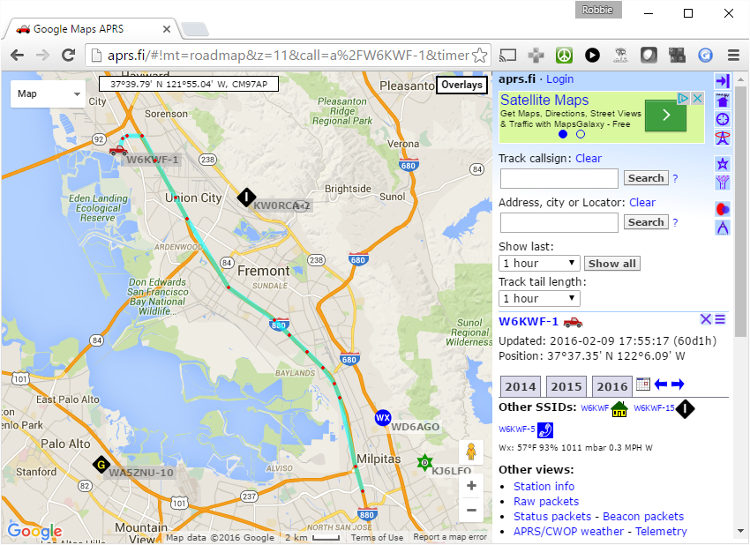
What does APRS look like?
Notes:
Walk through of APRS.fi show:
-Stations
-Tracks
-Messages
-Telemetry

Slide 5
Bell 202
1200 Baud AFSK using 1200Hz and 2200Hz tones.
Audio Frequency Shift Keying – using multiple tones in the audible range to encode data.

Slide 6
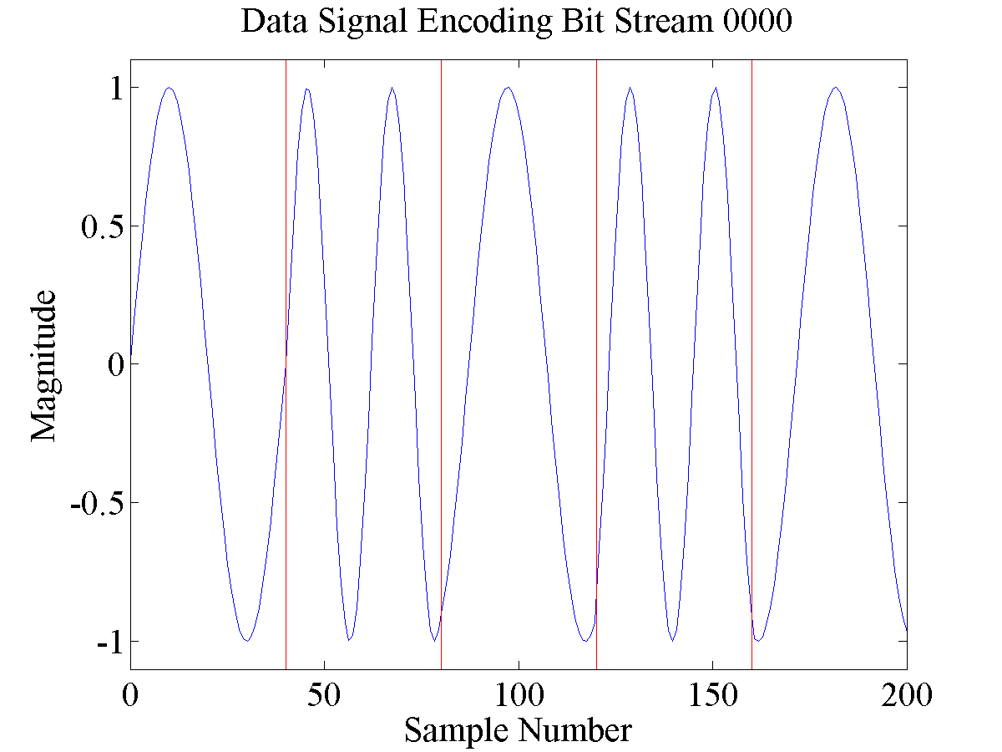
Example Signal
Notes:
1200Hz and 2200Hz tones.
Since 2200Hz doesn’t divide evenly in a 1200 baud bit period you can see that it changes the phase.

Slide 7

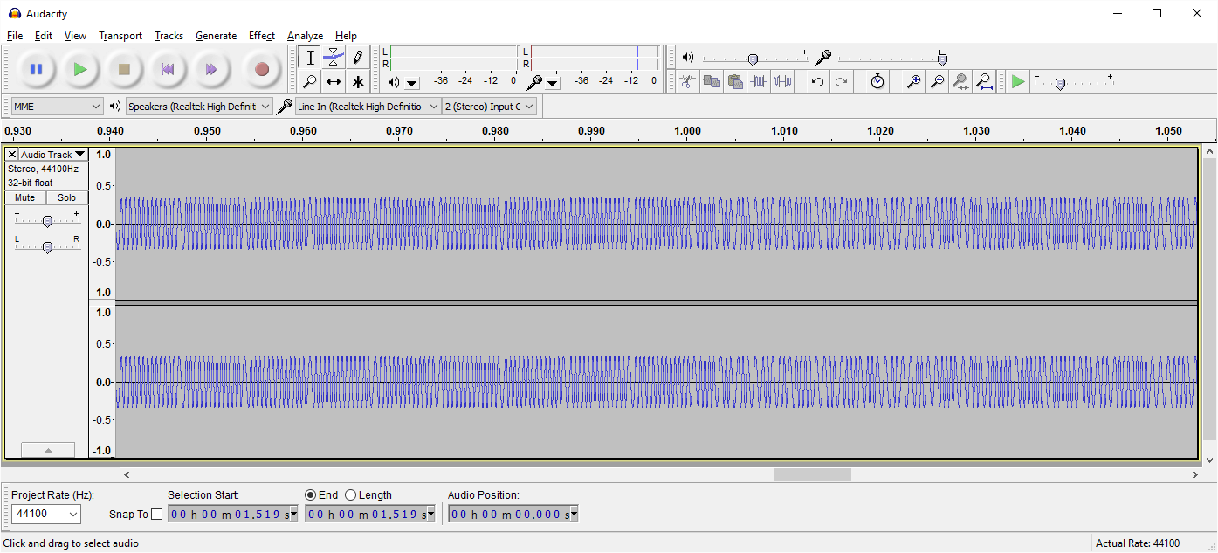
It’s in the audible range
What’s it sound like?
Notes:
Play Example APRS packet
Brief introduction to flags. Data is only contained in 0.5s worth of the audio file.

Slide 8
How to demodulate this signal?
Edge Detection
Correlation
Filters
Phase Locked Loop
Notes:
These approaches are shared in both hardware and software based approaches.

Slide 9
Edge Detection
Look for rising and falling edges
Distance between consecutive “zero-crossings” is λ/2

Slide 10
Correlation
Correlates original signal with expected signals.

Slide 11
Filters
Filters look at signal strength of individual frequencies

Slide 12
Phase Locked Loop (PLL)

Slide 13
Approaches to Accessing the Network
Terminal Node Controllers
Specialty APRS Hardware
Software

Slide 14
TNC Example: PK-232

Slide 15
TNC Example: MFJ-1278

Slide 16
TNC Example: Kantronics KAM

Slide 17
APRS Open Trackers

Slide 18
AGWPE

Slide 19
javAX25

Slide 20
Challenges
DC Offset
Noise
Emphasis

Slide 21
DC Offset

Slide 22
Noise

Slide 23
Emphasis

Slide 24
Algorithms Implemented
Zero Crossing
Goertzel (DFT / Filtering)
PLL
Preclocking

Slide 25
Zero Crossing

Slide 26
Goertzel (DFT / Filtering)

Slide 27
PLL

Slide 28
Preclocking

Slide 29
Benchmarking
OT3 Test
javAX25 Generated 200
OT3 Test + Ramping Noise
Track 1
Track 2

Slide 30
Clean Signal Example

Slide 31
Noise Example

Slide 32
Track 1 Example

Slide 33
Hardware Results - Clean

Slide 34
Hardware Results - Noise

Slide 35
Hardware Results – Track 1

Slide 36
Software Results - Clean

Slide 37
Software Results - Noise

Slide 38
Software Results – Track 1

Slide 39
Hardware versus Software

Slide 40
Ideas for Future Work

Slide 41
Conclusion

